Slide 1

More Than You Think
HL7 is people, HL7 is ideas, HL7 is collaboration

Slide 2
Healthcare Standards
Complex…. Slow…
Hard to use and understand
Require specialist skills, tools
Costly

Slide 3
Healthcare Standards
Complex…. Slow…
Hard to use and understand
Require specialist skills, tools
Costly
What if it didn’t have to be like that?

Slide 4
Introducing FHIR
Fast Health Interoperability Resources
Pronounced “Fire”
Based on industry best practices, with a focus on simplicity and implementability
…insert your fire related joke here….

Slide 5
REST & Resources
REST: a pattern for using web technologies to manage information
Resources: the building blocks that get exchanged
Like web pages, but for computer usage
Scalable – performance, and community

Slide 6
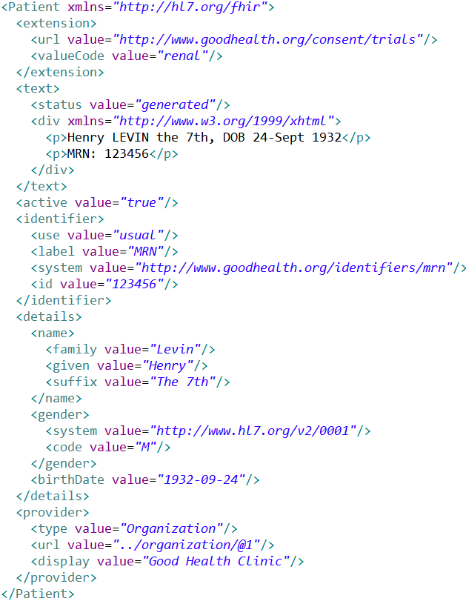
Extension with reference to its definition
Human Readable
Summary
Standard Data Content:
MRN
Name
Gender
Date of Birth
Provider

Slide 7
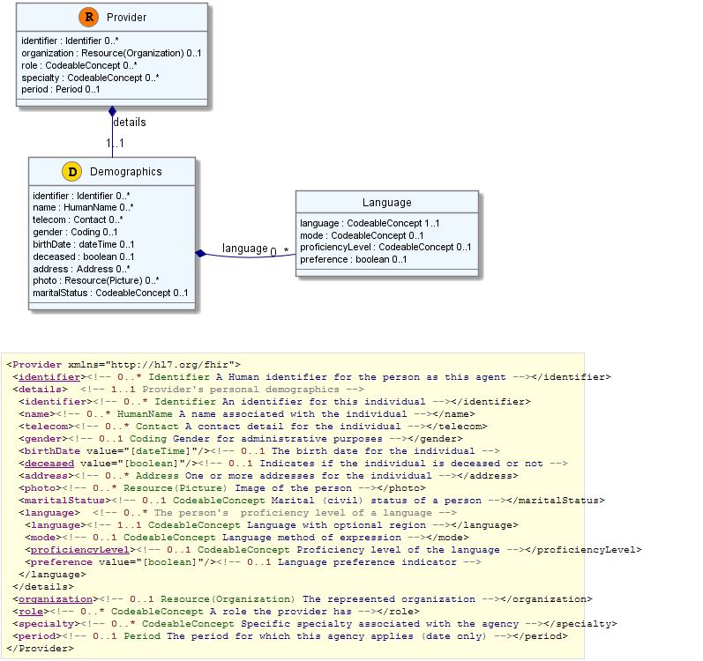

Slide 8
Resources have 3 parts
Defined Structured Data
The logical, common contents of the resource
Mapped to formal definitions/RIM & other formats
Extensions
Local requirements, but everyone can use
Published and managed
Narrative
Human readable (fall back)

Slide 9
Kinds of Resources
Administrative Concepts
Person, Patient, Organization, Device, Facility
Coverage, Invoice, etc.
Clinical Concepts
Allergy, Problem, Medication, Family History
Care Plan
Infrastructure Functionality
Document, Message, Conformance/Profiling

Slide 10
Using Resources
Classic Web RESTful approach
Simple approach led by Facebook, Twitter, etc.
Bundles – use Atom to group them
Internet syndication (publish/subscribe)
Messages (~v2), Documents (~CDA)
Custom Services (SOA)
Same content / base rules
Portability

Slide 11
Extensions
Managing extensibility is a central problem
Everyone needs extensions, everyone hates them
FHIR tames extensibility
Built in extensibility framework (engineering level)
Define, publish, find extensions
Use them
This tames the overall specification

Slide 12
FHIR Ethos
Simplicity / Web alignment
Implementation focused
Reference Implementations (C#, Java, etc)
Publically available test servers (now)
Connectathons
Freely available
http://hl7.org/fhir
Unencumbered – free for anyone to use

Slide 13
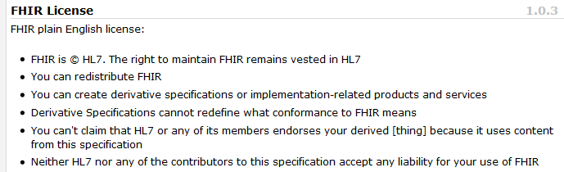
License

Slide 14
Status
DSTU published Feb 3rd 2014
Stable version for trial use
Subject to further change based on experience
Widespread Community Growth and Adoption
Demonstrations at the Interoperability Showcase (or see Harris, Cerner, Intermountain Healthcare)
Interest from National Programs

Slide 15
FHIR & CCDA
CCDA is mandated by Meaningful Use
FHIR is a new specification
FHIR is not a replacement for CCDA (yet)
Project to migrate CCDA content to FHIR
In the future, FHIR may gradually replace CCDA

Slide 16
Follow Up
Read the spec: http://hl7.org/fhir
Follow #FHIR on Twitter
Become part of the community:
Come to a Connectathon!
Make comments online
Join the FHIR email list http://wiki.hl7.org/index.php?title=FHIR_email_list_subscription_instructions
Implement it
Come to the next meeting (Phoenix in May)

Slide 17
FHIR
Simple…. FAST…
Easy to use and understand
Standard skills, tools
Cost-effective information sharing

